Slide 1
Emotional Intelligence in the Workplace
Dr. Al Carlozzi
Fallyn Lee
OSU-Tulsa Counseling Center

Slide 2
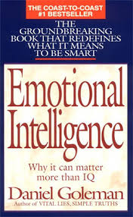
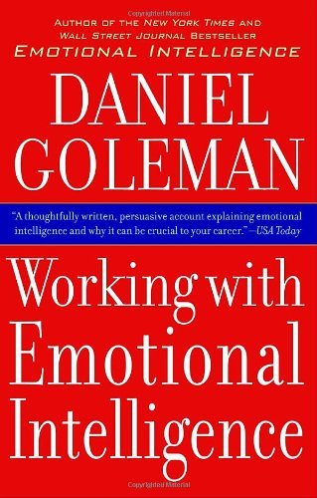
Daniel Goleman

Slide 3
What is Emotional Intelligence (EQ)?
The ability to be aware of, name, and manage or regulate one’s own emotions
The ability to be aware of, name, and understand the emotions of others
The ability to relate to others effectively, both personally and professionally, in a wide range of roles and settings

Slide 4
Why is EQ Important at Work?
Our ability to work together is influenced by our emotions
Being aware of our emotions helps us to think before we act (self-reflection)
EQ helps us manage emotions and behaviors (self-regulation)
Being aware of others’ emotions helps us understand and connect with them as people and as co-workers (empathy)
People with high EQ are more empathic, open to diverse perspectives, resilient, motivated, interpersonally competent, and successful at work

Slide 5
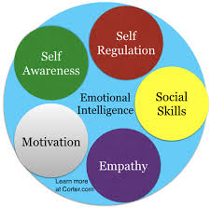
Components of EQ

Slide 6
Evidence of Low EQ in the Workplace
Blaming others
Seeing oneself as the victim in many situations
Inability to hear critical feedback, no matter how constructively provided
Diverse perspectives are neither welcomed nor valued
Inability to adapt to change
Passive, aggressive, or passive-aggressive communication
Triangulation
Decreased motivation, satisfaction, and success at work

Slide 7
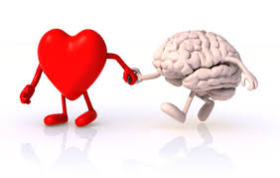
EQ Involves Emotion and Cognition

Slide 8
How Does EQ Develop?
Personality and temperament
Social role-taking opportunities
Experiences help “shape” the brain
Habits deeply learned early in life
Habitual repertoire of feelings, thoughts, and actions are so heavily learned that they become established in the brain as default responses that are automatic and spontaneous, often with little awareness of choosing to do so

Slide 9
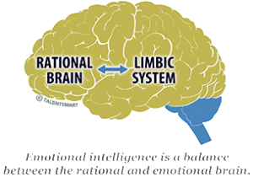
Our Brains

Slide 12
EQ Can be Improved
Research has shown that EQ is changeable
If you are willing and desirous of improvement, you can change
Benefits are not limited to career, but higher EQ contributes to greater general happiness, better mental and physical health, improved relationships, and a decrease in levels of cortisol, the stress hormone
Five ways to boost EQ

Slide 13
1. Improve Self-Awareness
Attend to how you feel and the sources of your emotions
Recognize that emotions are fleeting and should not always be the basis of communication and action
Consider how your negative emotions might affect others with whom you work
Think about ways you can manage your emotions to avoid saying or doing things you might regret
Do an honest self-assessment of how well you handle your emotions in given situations

Slide 14
2. Improve Self-Regulation
In emotionally-charged situations, wait a while, allowing time to think before you respond or make a decision
Stay uninvolved in office drama, in “us” versus “them” groupings and side-taking (avoid triangulation)
Accept that frustrations and disappointments are part of all work environments and part of life
Rather than complaining, blaming, or acting out, present ideas for solving problems in a calm and professional manner
Find ways to manage your stress outside of work through exercise, meditation, hobbies or other interests, talking with family and friends

Slide 15
3. Improve Motivation
Focus on what you love about your job, what you find fulfilling (your passion and enthusiasm for your work)
Practice optimism (consciously changing your thoughts and words from negative to positive, acting as if)
Establish inspiring yet realistic goals and steps you can take to reach those goals
Recognize that fellow workers are attracted to positive, inspiring, and energized people

Slide 16
4. Improve Empathic Skills
Practice active listening, making every effort to hear what others are feeling and thinking
Rather than judge others, make conscious efforts to see others’ points of view (perspective-taking)
Validate or acknowledge the merit of the others’ points of view
Treat others the way you would like to be treated
Be interested more in achieving the best outcome, rather than in being right or winning

Slide 17
5. Improve Social Skills
Communicate effectively both verbally and in writing
If trying to persuade others, draw upon sound knowledge and reasoning, as well as your passion
Be even-handed and calm (the voice of reason) committed to finding the best outcome
Know the persons with whom you are relating, finessing and tailoring your interactions to best fit their personality, culture, and position

Slide 18
Assessing Your EQ
https://www.mindtools.com/pages/article/ei-quiz.htm#groups

Slide 19
Case Illustration #1
You are feeling overwhelmed at work, with too many responsibilities and not enough time to fulfill all that has been piled on your plate. You are worried that if this continues, it will negatively affect your performance and your health. What are some emotionally intelligent ways to handle this?

Slide 20
Case Illustration #2
You hear through the grapevine that leadership is considering options for reorganizing your department. Some co-workers are very alarmed, and talk with others about worst case scenarios, while others are acting like there is nothing they can do or say about it. How might you feel, think, or act in response to such a rumor?

Slide 21
Case Illustration #3
You are a supervisor of several staff who work in an office that serves students. A staff member comes to you to inform you that she has observed another employee in the office being abrupt with students. She tells you that she wasn’t going to say anything to you, but noticed a student leave the office in tears after interacting with that employee. How can you handle this situation in an emotionally intelligent manner?

Slide 22
Case Illustration #4
You become aware that a couple of staff members are making negative comments about another staff member, who happens to be an LGBTQ person. What feelings and thoughts would you have about this, and what might be emotionally intelligent ways to handle it, if you were the supervisor or a fellow staff member?

Slide 23
Case Illustration #5
A staff member comes to work very happy after election day, and bursts into the office saying how thrilled she is that the person she voted for won the election. In what manner might an emotionally intelligent co-worker or supervisor respond to this person?

